Slide 1
Group C
MCTV LTD

Slide 2


Agenda
A
Introduction
Outline of Tasks
Overview of Database & UML chart
User guide
Conclusion

Slide 3
Introduction
MCTV Limited is a small retail company based in Limerick that has been trading for over twenty years, with a turnover of €1 million per annum and a staff of five people. The company sells televisions, and it is owned by Michael and Doreen Cooney, who are in their 60s and have little grasp of the benefits of technology.
Derek, the eldest son, manages the Sales & Marketing function, Roberta, a recently qualified accountant, aspires to be the Financial Controller for the company. Mark and Liam, the other two sons, are both in their final year at the University of Limerick, pursuing Computer Science and Electronics degrees, respectively. John is employed as a shop assistant on a part-time basis.

Slide 4
Outline Tasks
Project Fact Sheet- This was a document that we had to fill in with facts on the project and to add are thoughts and what we did during the project.
Microsoft Database- We were required to create a database for the company using the data provided in the Excel Workbook but also additional data that we thought might be useful for the company.
Use Case Diagram (UML)- We are required to create a Use Case Diagram for our database demonstrating how data flows.
GitHub- We were required to use GitHub to share are documents. At the end we must run a report and include this in our document.
Trello (Gantt Chart)- This is a Project Management tool that we had to use each week to ensure our team has visibility of the tasks being completed, their status and who is working on them. It was the responsibility of each team member to update and complete all tasks assigned to them.
WordPress- We were required to create a Website on WordPress for our Project.
Presentation- We also had to create a presentation on PowerPoint the presentation had to last 10 minutes.

Slide 5
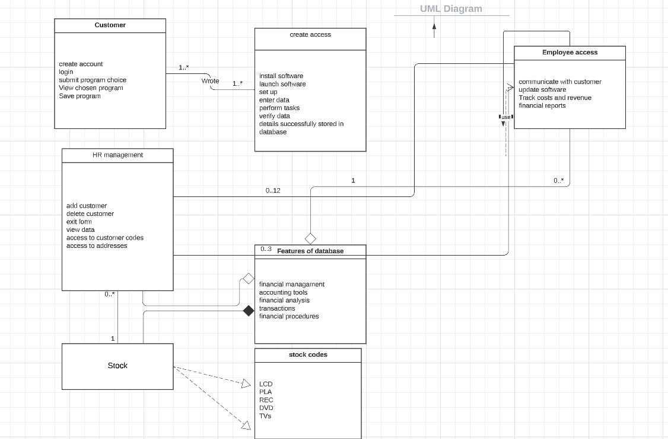
Overview of Database & UML Chart

Slide 6
What software each individual has decided to invest
Derek has decided to invest in a customer relationship management (CRM) system to enhance customer relationship.
Mark has decided to invest improving their website and enabling online payments through a cloud-based environment.
Roberta has decided she wanted to invest in from moving from excel to an integrated accounting package like Sage.
Liam has decided to invest in collaborative software to break the silos of information and enhance teamwork.

Slide 7
User Guide (Mark)
Sign up for an account.
Go to the website and click on the "Sign Up" button.
Enter your personal information, such as your name, email address, and password.
You will receive an email with a verification link. Click on the link to verify your account.
Set up your payment page.
Create a payment page by choosing a template or creating a custom page design.
Add your payment details, such as the amount, currency, and payment methods you accept.
Customize the checkout experience by adding your branding and logos.
Go Live
Once you have tested your payment page, you can switch to live mode and start accepting real payments.
Monitor your payment transactions and account activity through your dashboard.
Connect to your payment provider.
Once you have verified your account, log in to your dashboard.
Navigate to the "Payment Providers" section and select your payment provider.
Follow the instructions to connect your payment provider account to your software account.
Test your payment page.
Use the test mode to ensure that your payment page is functioning correctly.
Use the payment buttons on your payment page to make a test payment to ensure everything is working as expected.
Manage your Payments.
You can manage and track all your payment transactions and activity from the software dashboard.
You can also issue refunds, view transaction details and reports, and manage your customers' payment information.

Slide 8
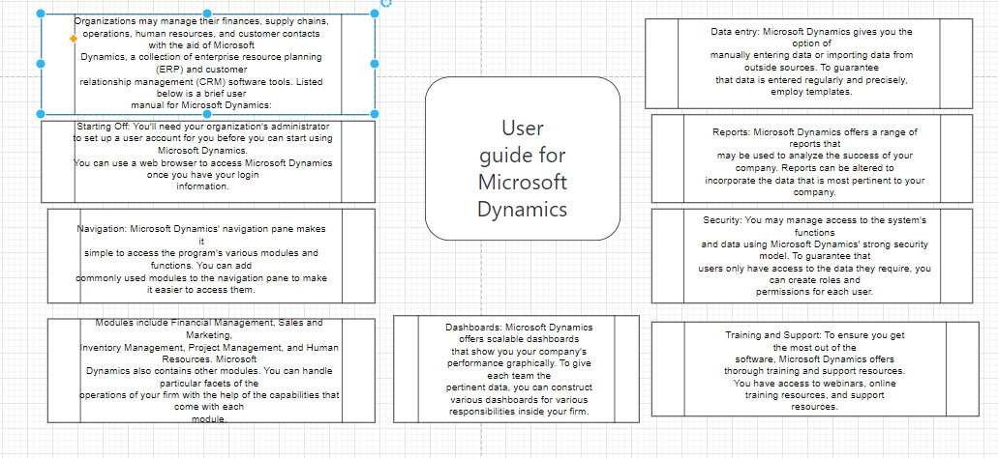
User Guide (Derek)

Slide 9
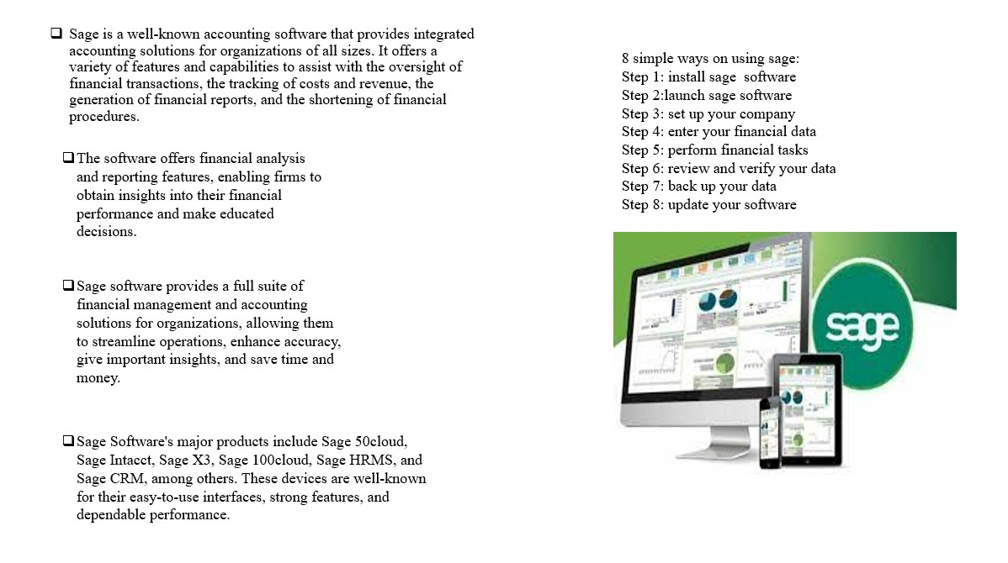
User Guide (Roberta)

Slide 10
User Guide (Liam)
I am advocating for the use of this collaborative software to improve the sharing of information and collaboration within the organization.
Collaborative software, particularly cloud-based solutions, the software offers features to enable employees to work together more effectively, regardless of their location or device. By breaking down the systems of information and allowing data to be shared more easily, collaborative software can help improve decision-making, increase efficiency, and promote innovation.
Investing €100,000 in collaborative software is a smart move for the business as it is looking to grow and remain competitive in today's market. It is important to choose the right software solution that meets the specific needs of the business.
There are many features of the software available, ranging from project management tools to communication and collaboration platforms to financial management and accounting solutions. It is important to assess the specific needs of the business and select a solution that will enable employees to work together more effectively, streamline workflows, and improve overall productivity. In addition to this, proper training and support for the software are important and provided to ensure that employees are able to use it effectively and get the most out of the investment.

Slide 11
Conclusion
The overall project was very difficult the Microsoft database wasn’t easy to complete as we had to add at least 4 more tables to the information that was already there. But with teamwork, we’re able to concentrate and complete the Microsoft database for MCTV LTD.
The WordPress website was difficult to get started but once we understood from watching videos available on Moodle, we quickly understood what to do. It was difficult to make a template for the UML chart from scratch but with the help of diagram.io, we were able to complete the UML chart successfully.
The presentation was the easiest thing to finish as we had all the information completed to gather & finish the assignment.
Overall, we are glad to have experienced a complex but hard group assignment it was rewarding to work together on such a complex assignment.

Slide 12
Thank you
Group C
By Shaman, Safa, Viola & Chidimma

